Slide 1
EMPLOYEE ATTRITION ANALYSIS

Slide 2
PROBLEM DEFNEATION
Employee attrition is a major HR challenge because employees leaving an organization can affect workforce stability, productivity, and retention planning. This project aims to analyse employee data and identify the demographic, salary, workload, workplace, engagement, burnout, work-life balance, and AI-related factors associated with employee attrition.

Slide 3
project questions
Does age influence attrition? Does salary influence attrition? Does overtime relate to attrition? Does burnout relate to attrition?
Does manager support influence attrition
Worklife balance influence attrition Does employee engagement relate to attrition? Is perceived AI job risk associated with attrition?

Slide 4
Dataset Employee HR Analytics Source
Kaggle Domain
. Human Resources (HR) ○ Employee attrition or retention reports Data Size 5,000 rows × 29 columns Volume 5,000 employee records Data Type Numerical and categorical employee data Main Target Employee Attrition

Slide 5
Data Cleaning & Preparation Data Cleaning Steps Loaded the dataset using Pandas. Checked dataset structure — rows, columns and data types. Checked missing values — no missing values were found. Checked duplicate records — no exact duplicates were found. Checked data types and prepared variables for analysis. Created attrition flag: 0 = Stayed 1 = Left Created derived categories for analysis, such as: Age Group Salary Category Overtime Category Burnout Category Engagement Category Work-Life Balance Category Prepared numerical and categorical variables for visualization and statistical analysis.

Slide 6
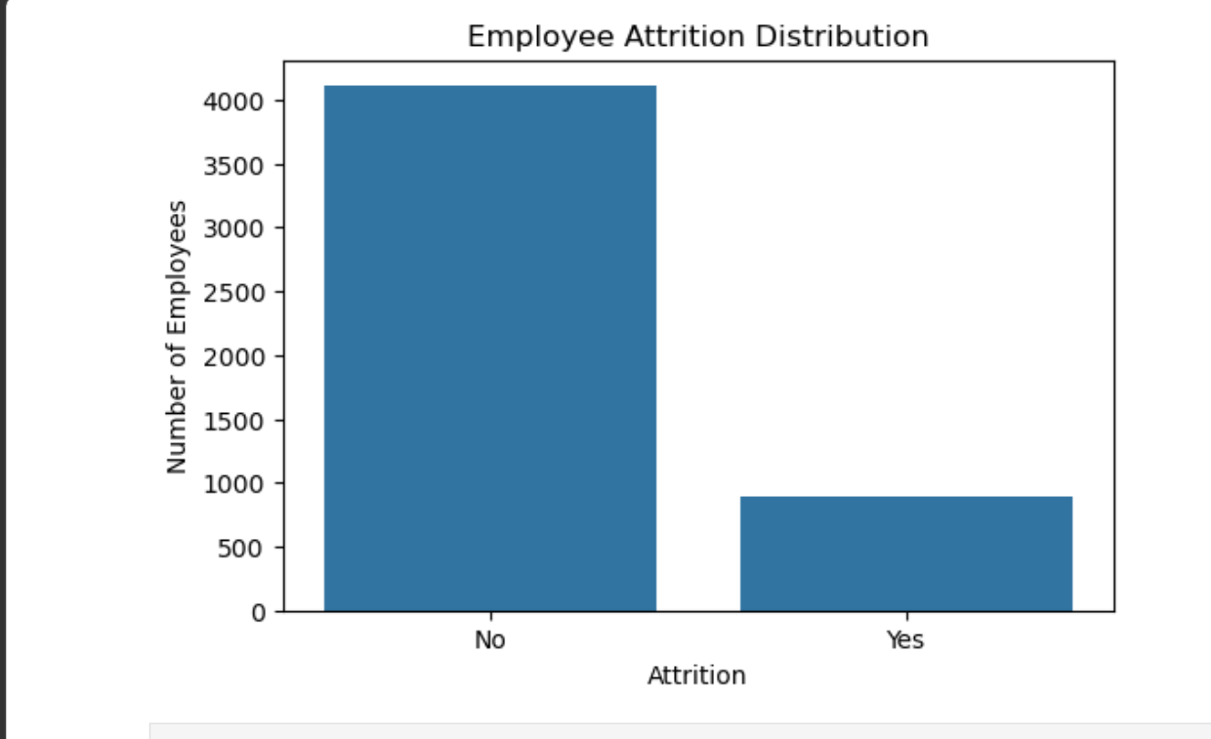
Employee Attrition Distribution The chart shows the number of employees who stayed and left the organization. No: Approximately 4,000+ employees did not leave the organization. Yes: Approximately 500–600 employees left the organization. Therefore, the dataset has many more employees who stayed than employees who left. This indicates that attrition is a minority outcome in the dataset.

Slide 7
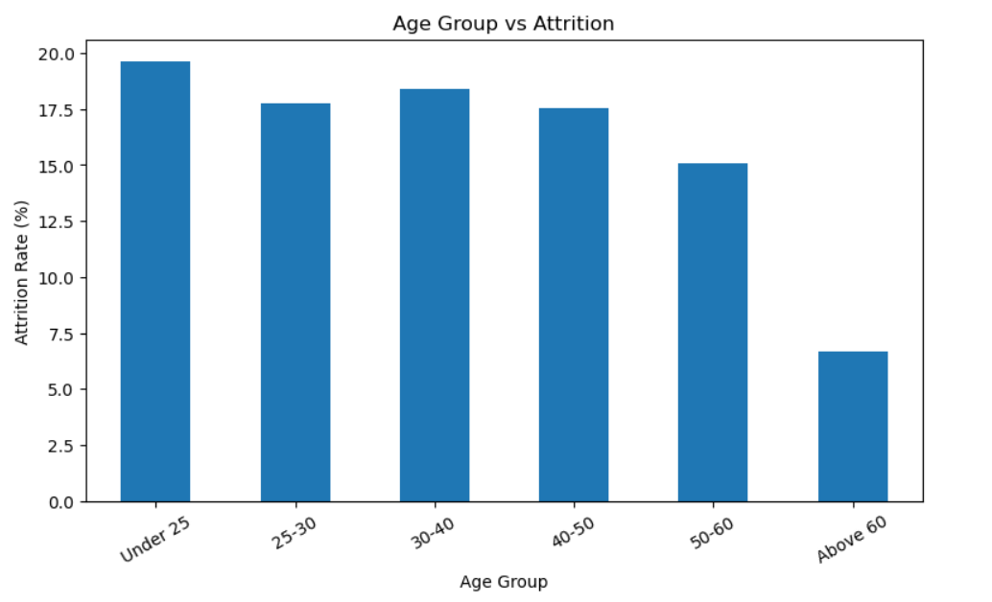
Age vs Attrition The chart compares attrition rates (%) across different age groups. Under 25 has the highest attrition rate, at approximately 19.6%. 30–40 has the second-highest rate, at approximately 18.4%. 25–30 and 40–50 have similar attrition rates, around 17–18%. The 50–60 group has a lower attrition rate of approximately 15%. Above 60 has the lowest attrition rate, around 6.7%. Overall, the chart suggests that younger employees, particularly those under 25, have relatively higher attrition in this dataset. The Above-60 result should be interpreted cautiously because this group has only 15 employees. “The Under-25 age group has the highest attrition rate at approximately 19.6%, while the Above-60 group has the lowest at approximately 6.7%. Overall, younger employees show relatively higher attrition in this dataset.”

Slide 8
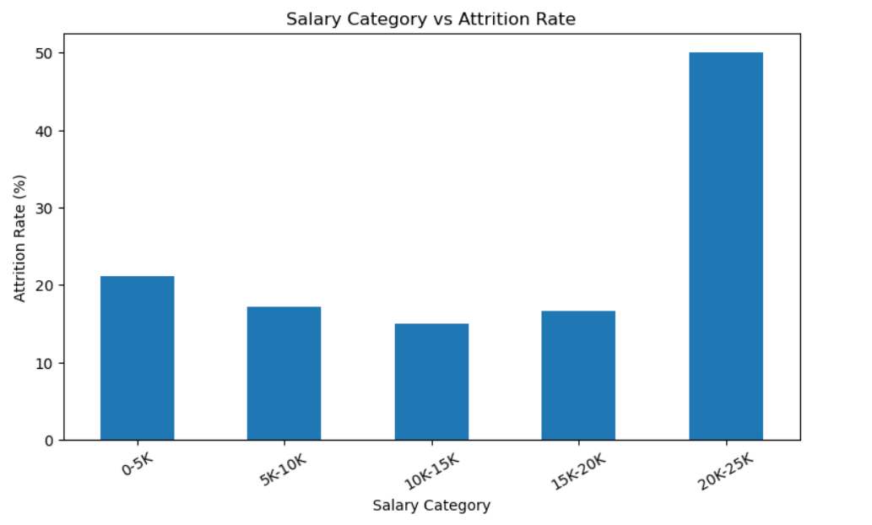
Salary Category vs Attrition Rate The chart compares attrition rates across different salary categories. The ₹20K–₹25K salary category has the highest attrition rate, at approximately 47–48%. The ₹0–₹5K category has the second-highest attrition rate, at approximately 21%. The ₹5K–₹10K category has an attrition rate of approximately 17%. The ₹15K–₹20K category has an attrition rate of approximately 15–16%. The ₹10K–₹15K category has the lowest attrition rate, at approximately 14%. Therefore, in this dataset, the ₹20K–₹25K group shows an unusually high attrition rate compared with the other salary categories. “The ₹20K–₹25K salary category has the highest attrition rate at approximately 48%, while the ₹10K–₹15K category has the lowest at around 14%. This indicates a noticeable variation in attrition across salary categories.”

Slide 9
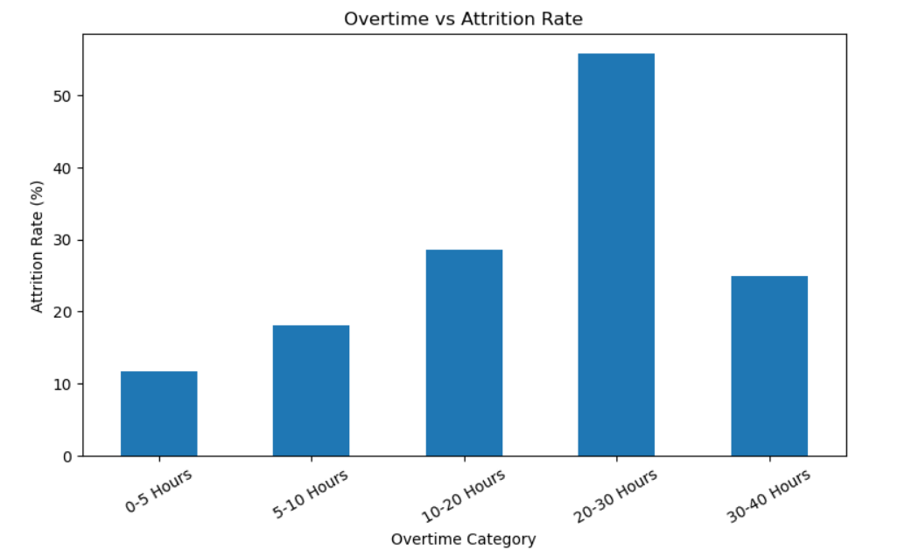
Overtime vs Attrition Rate — Explanation The chart compares attrition rates across different overtime-hour categories. Employees working 20–30 overtime hours per week have the highest attrition rate, approximately 56%. The 10–20 hours category has an attrition rate of approximately 29%. The 30–40 hours category has an attrition rate of approximately 25%. Employees working 5–10 hours have an attrition rate of approximately 18%. The 0–5 hours category has the lowest attrition rate, approximately 12%. Overall, the chart shows a strong association between overtime and attrition, particularly for employees working 20–30 overtime hours.

Slide 10
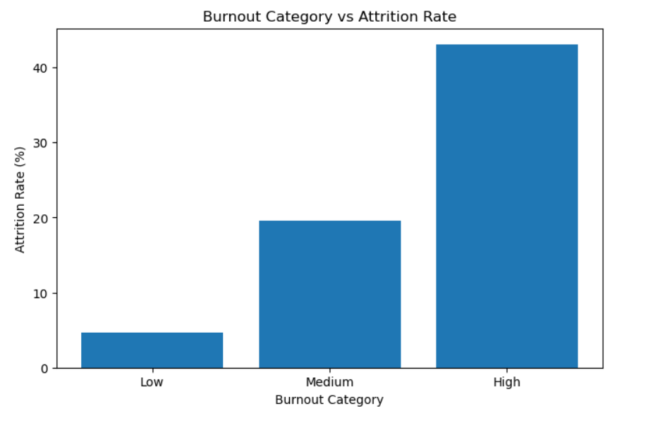
Burnout Category vs Attrition Rate
The chart compares attrition rates across three burnout categories: Low, Medium, and High. Employees with Low burnout have the lowest attrition rate, approximately 4–5%. Employees with Medium burnout have an attrition rate of approximately 19%. Employees with High burnout have the highest attrition rate, approximately 42–43%. There is a clear increasing pattern: as burnout increases, the attrition rate also increases. This suggests that higher burnout is strongly associated with higher employee attrition in this dataset.

Slide 11
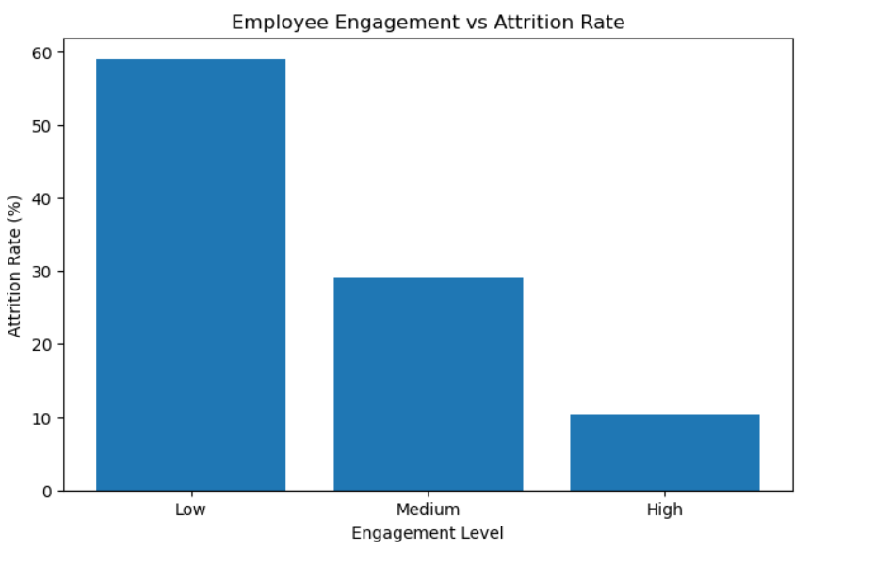
Employee Engagement vs Attrition Rate The chart compares attrition rates across three engagement levels: Low, Medium, and High. Low engagement has the highest attrition rate, approximately 59%. Medium engagement has an attrition rate of approximately 29%. High engagement has the lowest attrition rate, approximately 10–11%. There is a clear decreasing pattern: as employee engagement increases, attrition decreases. This suggests that higher employee engagement is strongly associated with lower attrition.

Slide 12
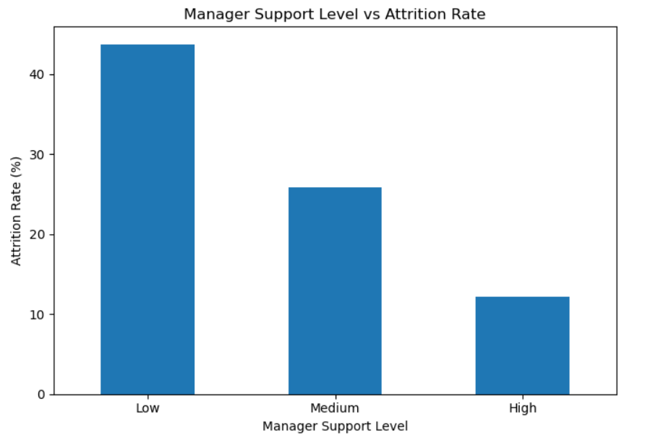
Manager support vs attrition
The analysis shows a clear relationship between manager support and employee attrition. Employees who receive lower management support tend to have higher attrition, meaning they are more likely to leave the company. As the manager support level increases, the attrition level generally decreases. Employees with high manager support are more likely to stay with the organization. Therefore, improving manager support, communication, and guidance may help reduce employee turnover and improve employee retention.

Slide 13
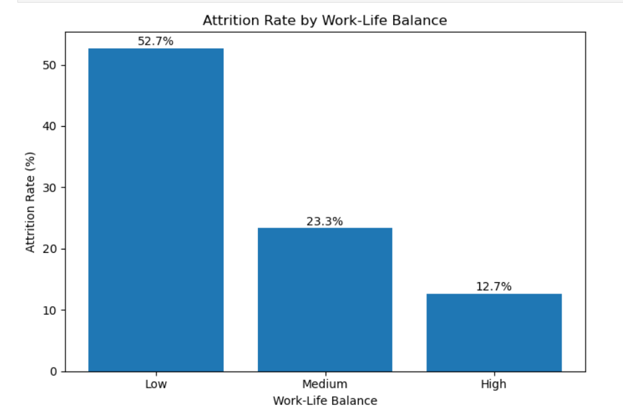
Work-Life Balance Distribution vs attrition
The chart shows the distribution of employees by work-life balance category. High work-life balance represents the largest group, at 52.7%. Medium work-life balance represents 23.3% of employees. Low work-life balance represents 12.7.1%. If the work life balance increases attrition rate is decreasing and vice versa

Slide 14
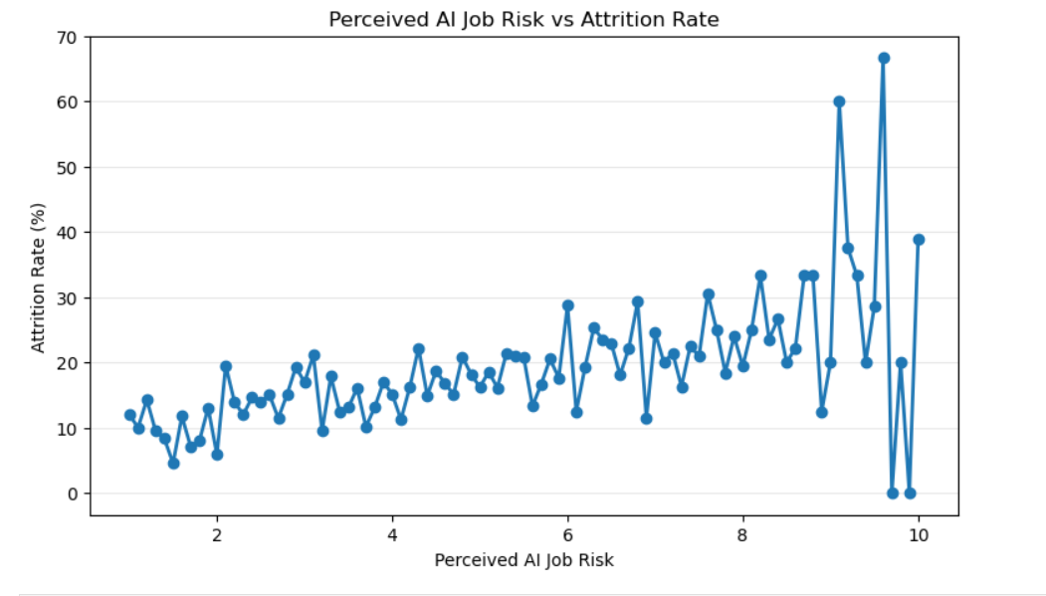
Perceived AI Job Risk vs Attrition Rate The chart compares perceived AI job risk scores with employee attrition rates. The AI job-risk score ranges approximately from 1 to 10. At lower AI job-risk levels, attrition rates are generally around 10–20%. As perceived AI job risk increases, the attrition rate generally shows an upward trend. At higher risk levels, there are several points with substantially higher attrition rates, including values above 40% and 60%. However, there is considerable variation at the higher risk levels. Overall, the chart suggests a positive association between perceived AI job risk and attrition in this dataset.

Slide 15
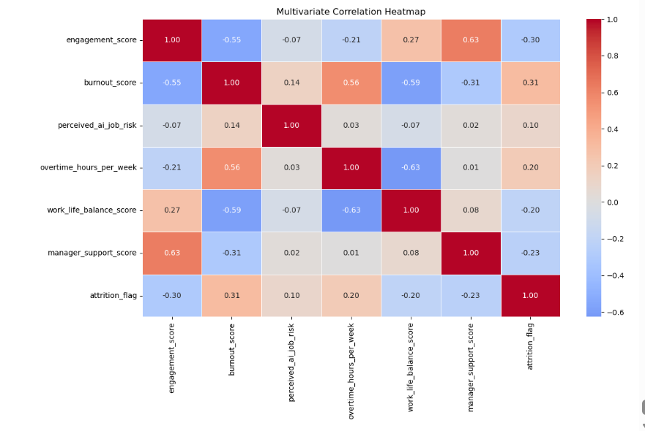
Multivariate Analysis & Conclusion The analysis shows that engagement, burnout, overtime, work-life balance, and manager support have meaningful relationships with employee attrition.
Higher engagement → lower attrition. Higher burnout → higher attrition. More overtime → higher attrition. Better work-life balance → lower attrition. Higher manager support → lower attrition. AI job-risk perception has a relatively weaker relationship with attrition. Conclusion Overall, employee attrition is more strongly associated with workplace well-being and working conditions than AI-related concerns. Improving engagement, work-life balance, manager support, and workload management, while reducing burnout and excessive overtime, may help improve employee retention.

Slide 16
Final Conclusion Employee attrition varies across age, salary, overtime, burnout, engagement, and perceived Al job risk. Under-25 employees recorded the highest age-group attrition rate at approximately 19.6%. Attrition increases substantially with overtime, with the 20-30 hours category showing the highest rate in the analysis. High burnout is strongly associated with higher attrition: approximately 43%, compared with about 5% for low burnout.
Higher manager support level reduce the attrition rate and the lower level show higher attrition Low engagement is associated with much higher attrition, approximately 59%, while high engagement is around 10%. Higher perceived Al job risk generally shows an upward relationship with attrition, although there is considerable variation. Overall, employee well-being, engagement, workload, and job-related concerns appear to be important areas associated with employee turnover.

Slide 17
Recommendations / Suggestions 1. Reduce over time by monitoring workload and staffing 2. Address employee burnout through workload management, regular feedback, and employee-support initiatives. 3. Improve employee engagement through recognition, career-development opportunities, and employee feedback. 4. Promote work-life balance through flexible working practices and reasonable workloads. 5. Focus on younger employees, particularly the Under-25 group, through mentoring and career-development programs. 6. Monitor Al-related job concerns and provide employees with Al training and upskilling opportunities.
7. Improve manager support
8. Use department and salary-level attrition rates to identify specific groups requiring further investigation.

Slide 18
THANK YOU

